Slide 1
Problem description and pipeline

Slide 2
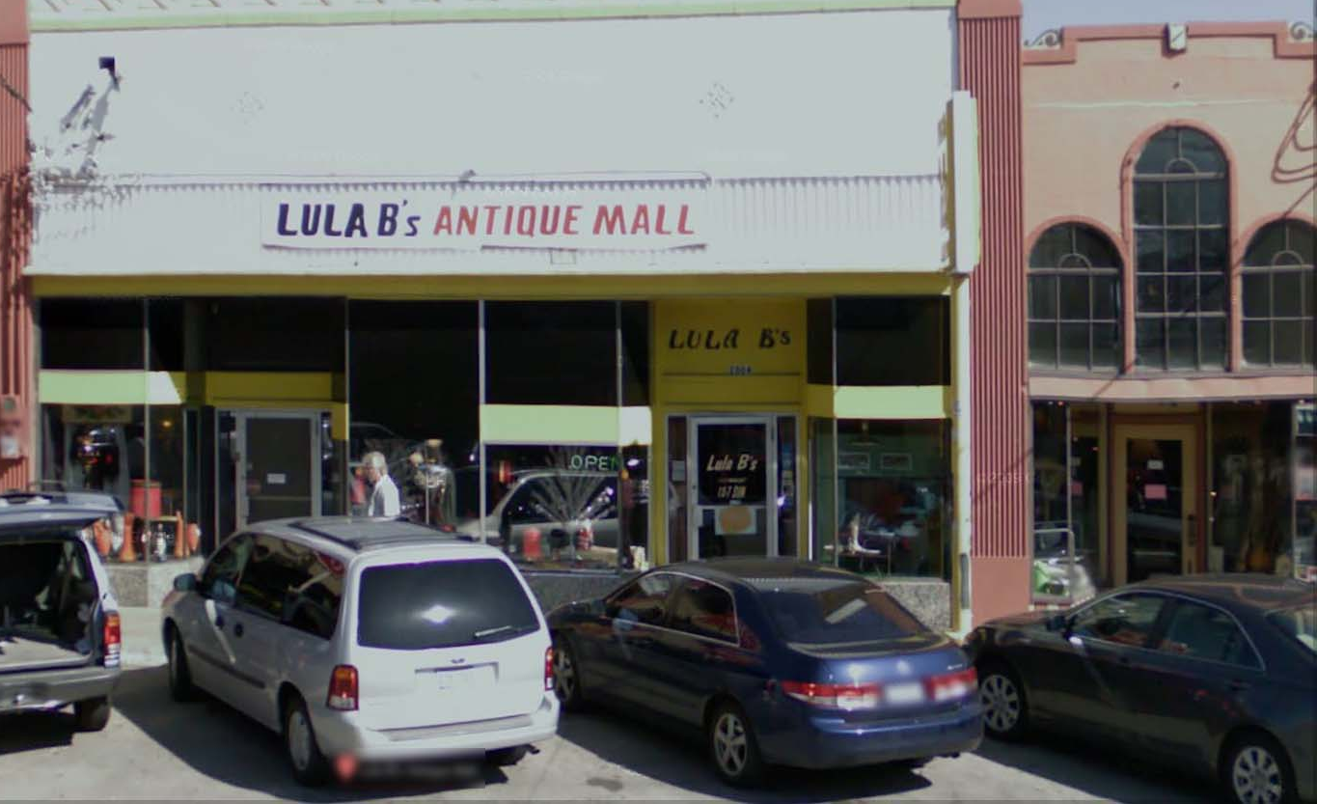
The Photo OCR problem
LULA B’s ANTIQUE MALL
LULA B’s
OPEN
LULA B’s

Slide 3
Photo OCR pipeline
1. Text detection
2. Character segmentation
3. Character classification
A
N
T

Slide 4
Photo OCR pipeline
Image
Text detection
Character segmentation
Character recognition
Engineers

